Slide 1



A Database of Infrastructure Externalities:
Estimating the Societal Impacts of Infrastructure Projects
December 2019
Abigail Schlageter

Slide 2
What?
IISD has developed a database that compiles available knowledge on the valuation of infrastructure project externalities, direct costs and climate risks.

Slide 3
Why?
Designed to support the estimation of financial performance of infrastructure assets.
It includes the value of externalities and climate risks that are typically unaccounted for in conventional project assessments.
It also provides some direct costs of infrastructure.

Slide 4
How?
Data Collection
Literature Review
      Data pulled from relevant peer-reviewed journals and case studies
  Public Data
      Data provided by governments, NGOs or businesses

Slide 5





Infrastructure Types
The database can be used to estimate costs related to transport, energy, water management, material management, building, mining, or nature-based infrastructures

Slide 6





What values does the database include?
Externalities
  Environmental (1,059 rows)
  Social (291 rows)
  Governance (4 rows)
Direct Costs (196 rows)
  Costs of implementation
  Costs related to operation and management
Climate Risk (511 rows)
  Effects of climatic changes on infrastructure
  Linkage to relevant Copernicus datasets

Slide 7


Externalities
included
Environmental
  Air pollution, climate change impacts, ecosystem services, environmental remediation, water discharge and pollution, and water use and withdrawal
Social
  Child labour, community development, customer satisfaction, changes in marketability, health and safety, labor demand, labor opportunity costs, and property value changes
Governance
  Bribery and corruption, and vision
  and monitoring

Slide 8
Direct costs included
Costs Related to Implementing Infrastructure
  Cost per unit of material
  Construction costs
  Maintenance costs
  Land use costs
  etc.
$
$
$

Slide 9
Climate risks included
Impacts of Climate Change on Infrastructure
  Changes in energy demand
  Changes in efficiency/ capacity of infrastructure
  Changes in durability/ performance of infrastructure
  Costs related to adapting/ failing to adapt to climate change

Slide 10

How does the database function?
Ability to Filter By:
  Infrastructure type
  Externality type
  Stage of the project life in
  which the cost is incurred
-/+
$$

Slide 11
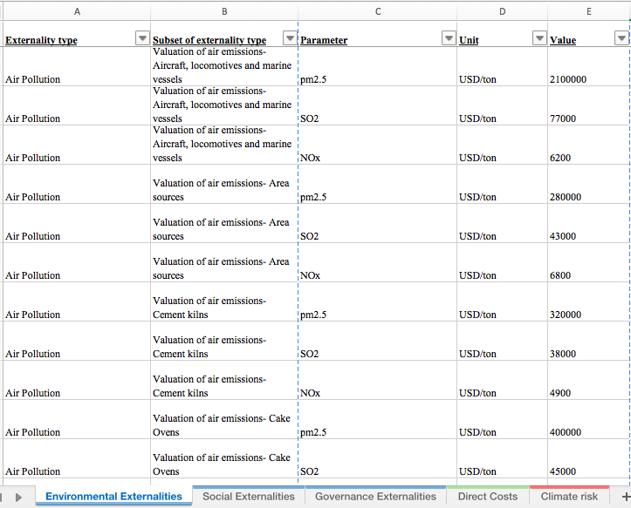
Database Structure:
Column A: Identifies externality being evaluated
Column B: Provides supplementary information on externality
Column C: Identifies the parameter
Column D: Identifies the unit and currency
Column E: identifies the corresponding value of the externality

Slide 12
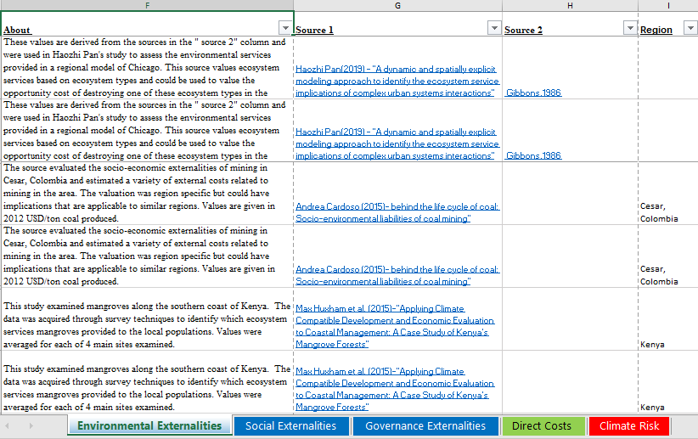
Column F:
Information about the source, the value and how the value was obtained
Columns G and H:
Linked sources
Column I:
Region (if value or case study are region-specific)

Slide 13
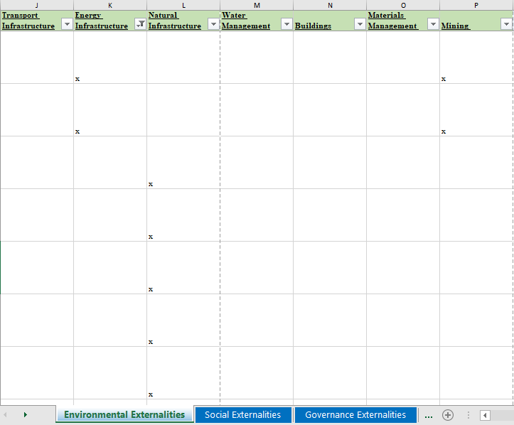
Columns J-P: Indicate which infrastructure type is impacted

Slide 14
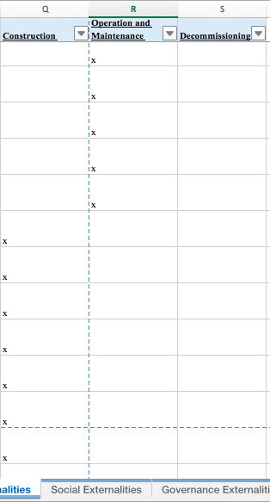
Columns Q-S:
Indicate in which part of the
infrastructure project’s life the cost is incurred:
  Construction
  Operation and management
  Decommissioning

Slide 15
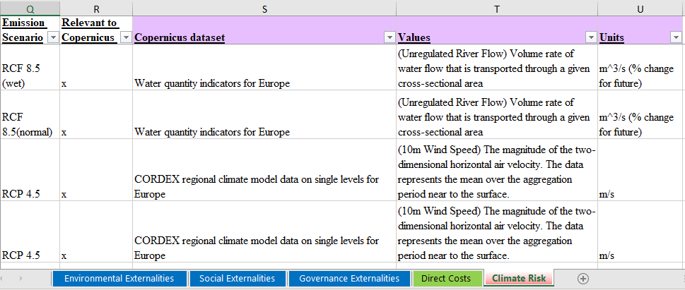
Within Climate Risk Tab:
Column Q:
Emissions scenario corresponding
to value
Column R:
Identifies if the value can be linked
to a Copernicus dataset
Column S-U:
The title of the relevant Copernicus dataset, the values that correspond and the units associated with these values.

Slide 16
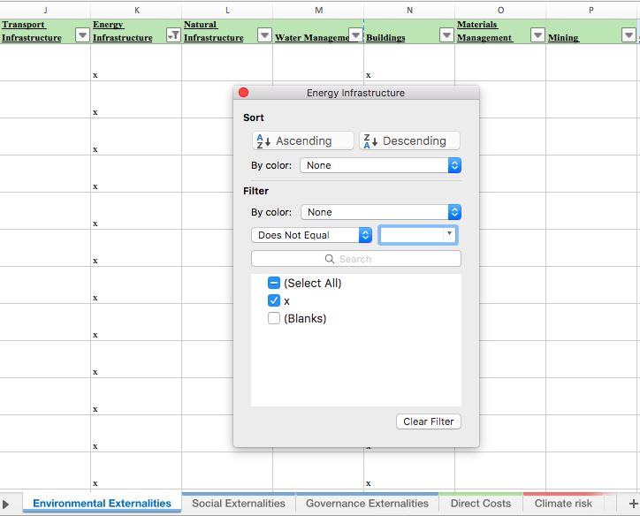
Example of Database’s Application
Scenario: Comparing Wind Energy and Coal-Powered Energy Sources
Select tab related to
externality type:
e.g. Environmental
Filter by infrastructure type (Columns J-P):
e.g. energy infrastructure

Slide 17
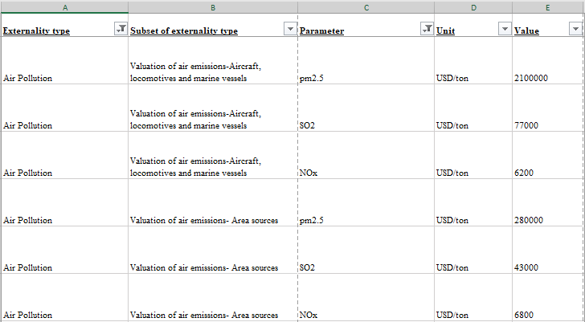
(iii) Filter by externality type that is of interest (Column A):
e.g. air pollution
-/+
$$

Slide 18
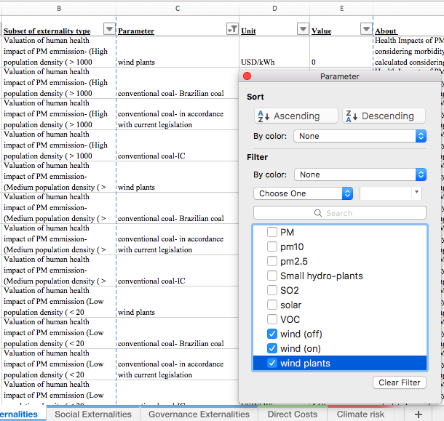
(iv) Filter further by parameter to obtain relevant values (Column C):
e.g. parameters relevant to wind and coal power generation

Slide 19
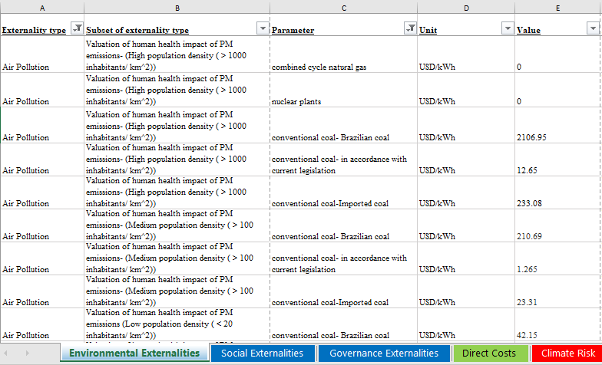
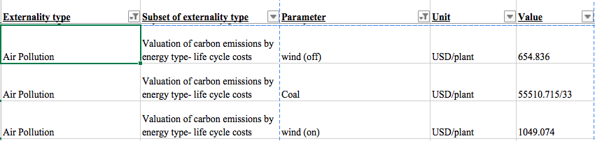
The database yields relevant information from two sources:
Health impacts from
particle emissions based
on population density
Cost due to carbon emissions over the lifecycle of each plant (based on carbon tax value)

Slide 20
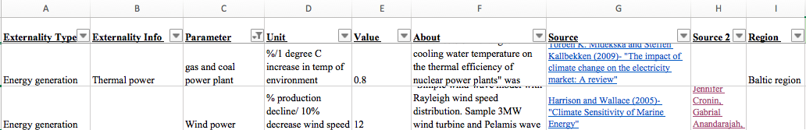
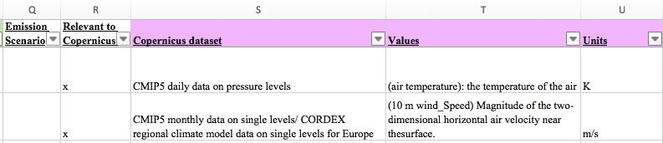
Similarly, filtering in climate risk tab with respect to wind generation
and coal generation yields information on plant performance
changes due to climatic changes:
The relevant Copernicus dataset is identified in Column S
(corresponding values and units in Columns T and U)

Slide 21
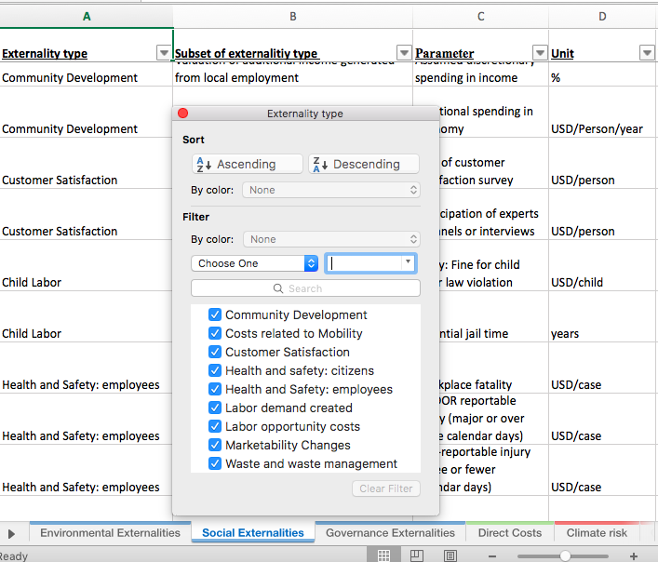
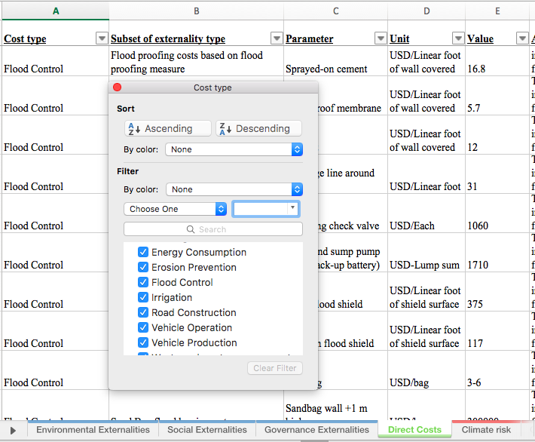
Similar strategies can be employed for other externality types, direct costs or infrastructure project types
Examples of social externalities and direct costs:

Slide 22
Thank You!

